Slide 1



Slide 2
Student Assistant

Slide 3
Student Assistant
Title of the App
Objective
To make an AI based software to make the online classes run more smoothly and effectively.

Slide 4
Synopsis

Slide 5
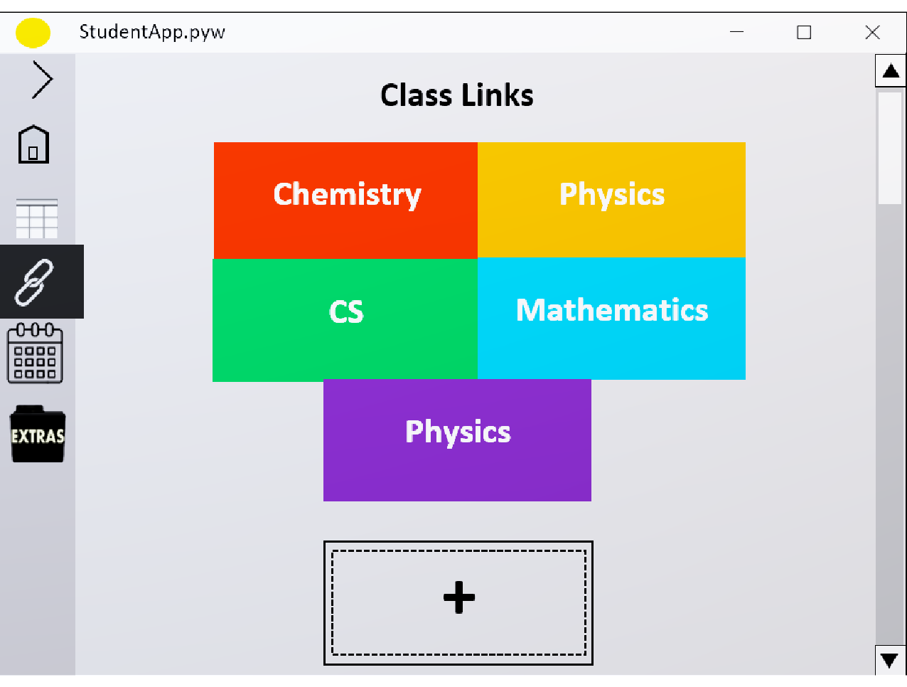
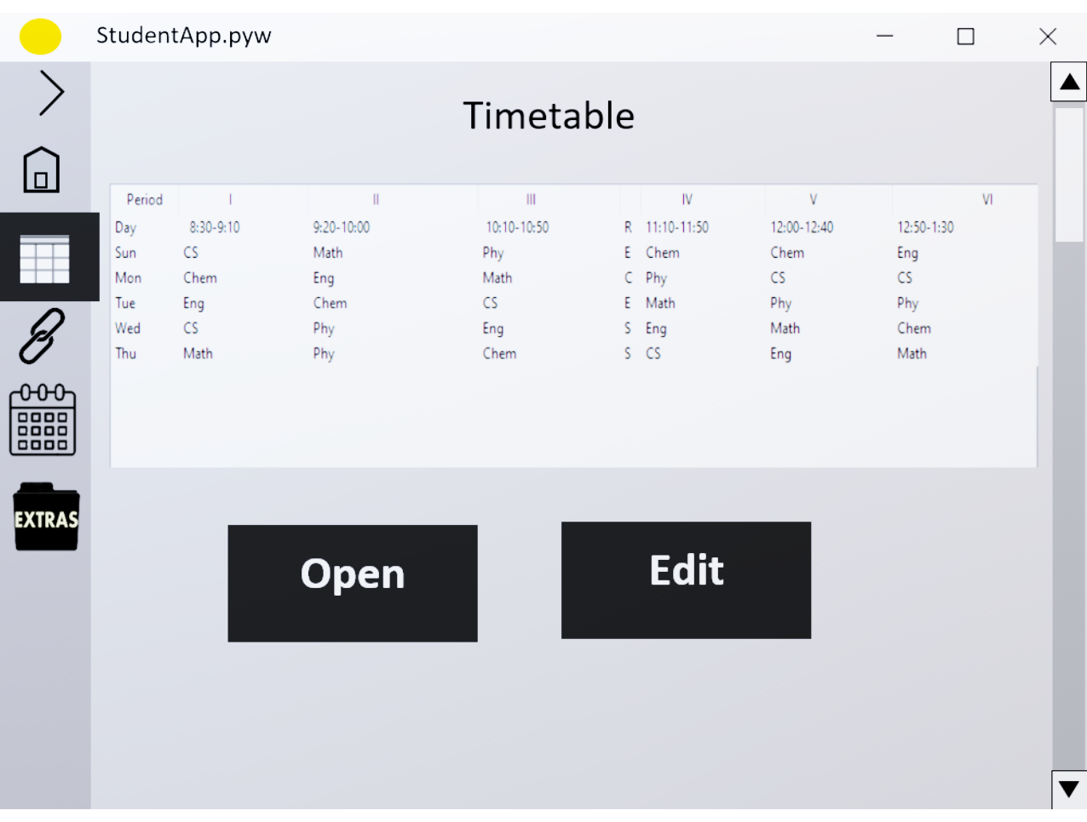
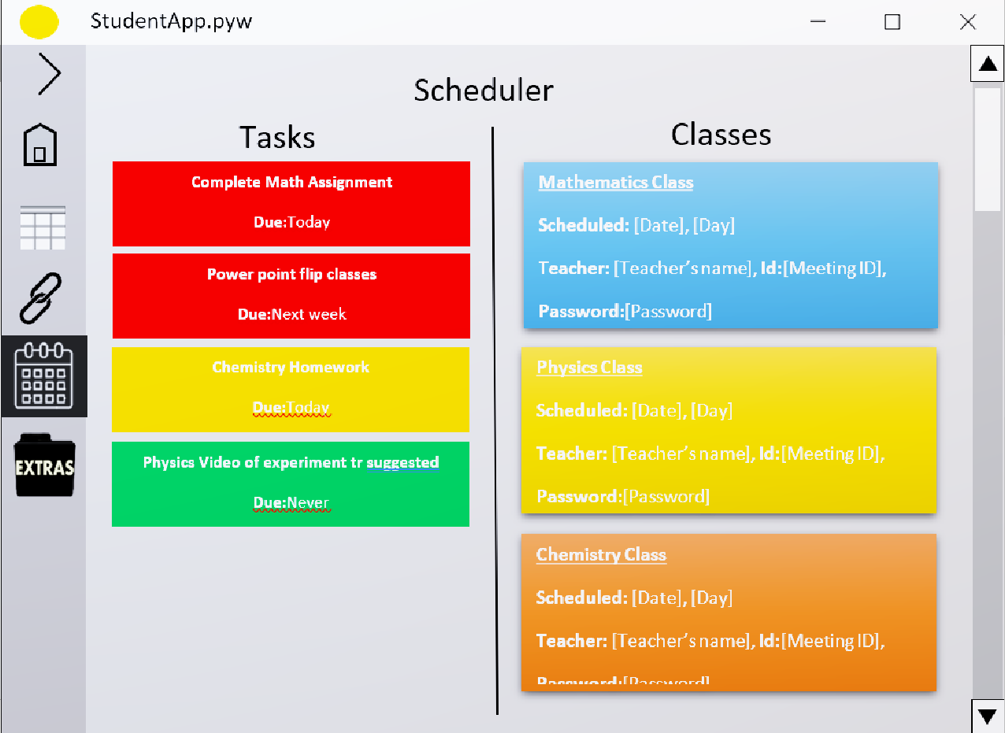
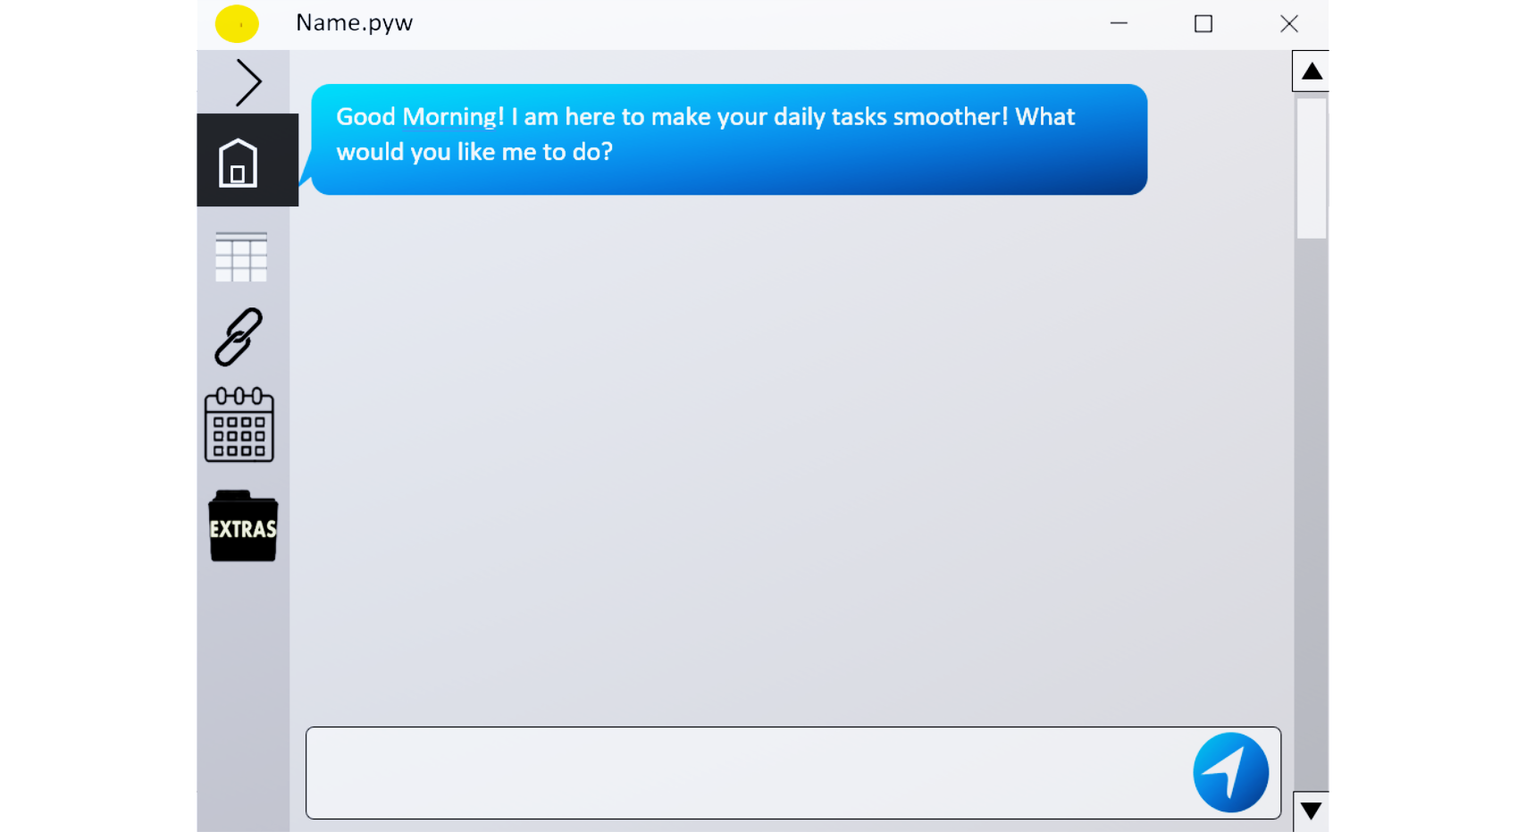
Scheduler Tab
Home Tab
Timetable Tab
Links Tab

Slide 6
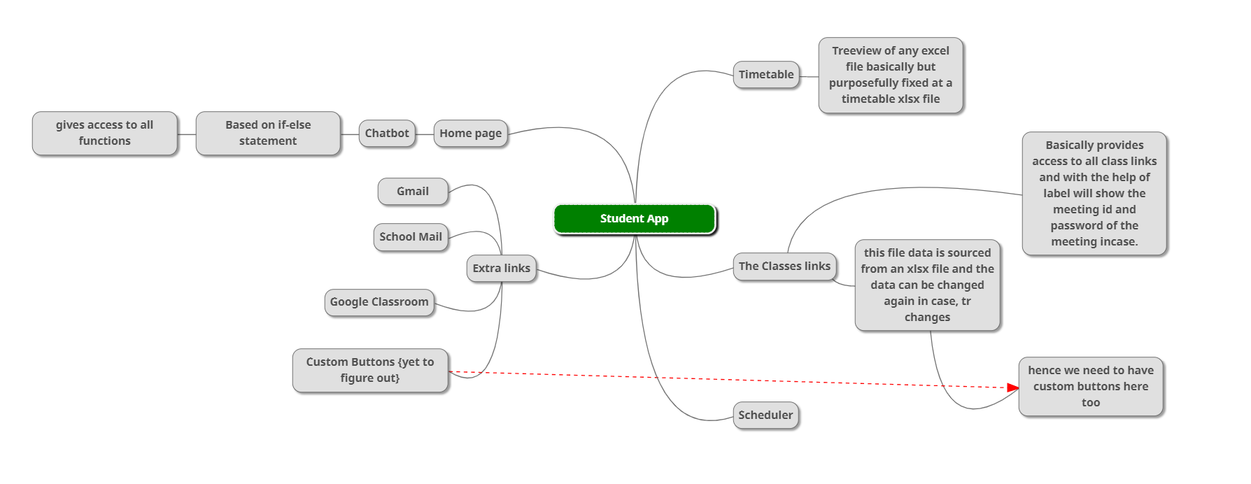
App at a glance

